Slide 1

XCEED - K!ODE-A-THON
BY:
SURYA NARAYANAN
RITHVIKAILAS

Slide 2
Problem Statement :
Communications between deaf-mute and a normal person have always been a challenging task especially in the public place.
Solution:
Our system is planned to be focused on the problem of gesture recognition in real time that sign language used by the community of deaf people and dumb people.

Slide 3
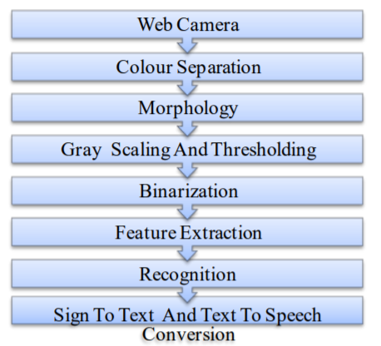
Algorithm:
Image is captured through web camera. The system should be implemented in offline mode and also in real time mode. Input images are applied to image pre processing and segmentation in which, object and background is separated. Resultant image has shown some features. Then feature extraction and recognition was done by using PCA and KNN. Finally, this result is converted into text and voice.
1. Database Creation
2. Preprocessing
3. Feature Extraction
4. Recognition

Slide 4
CONCLUSION:
The method should give output in text and speech format that helps to reduce the communication gap between deaf – mute and normal people. Thus the implementation of system output is done in MATLAB environment.
We want to make the deaf and dumb people to communicate like normal people.

